Slide 1

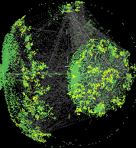
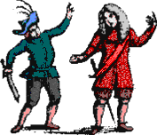
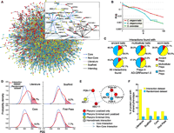
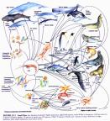
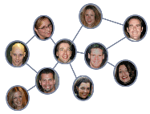
Social Network
Collaborations among…
Movie actors
Scientists and professors
Phone call patterns
Word co-occurrence in text
World Wide Web and hyperlink structure
Geo-colocations
Many others

Slide 2
Social Network Analysis (SNA)
A set of relational methods for systematically understanding and identifying connections among actors
draws heavily on graphic imagery
relies on the use of mathematical and/or computational models

Slide 3
Use SNA when you wish to
visualize data to uncover relationships or interactions [customer/employee/ alumni network]
trace information diffusion in network [seeding messages]
identify key players or different roles [opinion leaders, R&D networks]
identify sub-communities/cliques: isolated, dysfunctional, etc.
test hypotheses on network behaviors [repeated collaborations]
understand how to improve network effectiveness [info diffusion, or opinion leader selection]

Slide 4
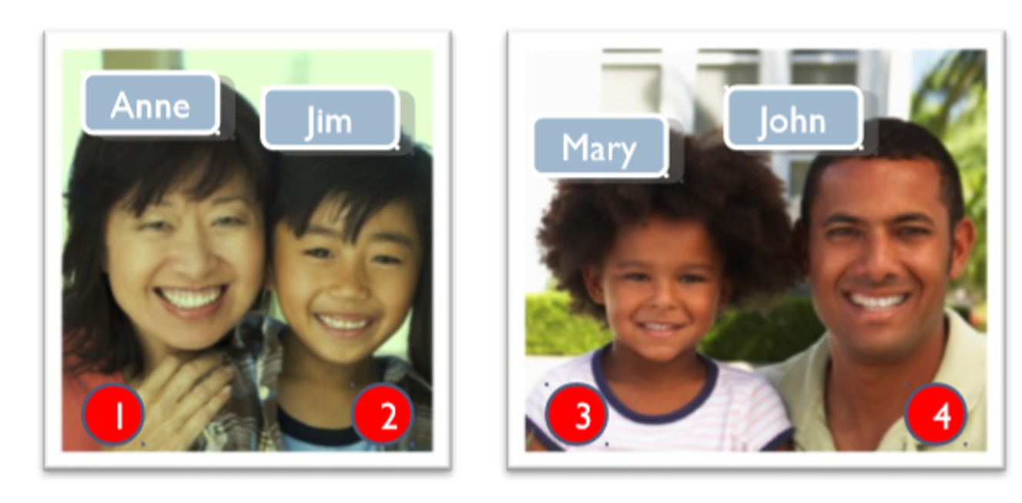
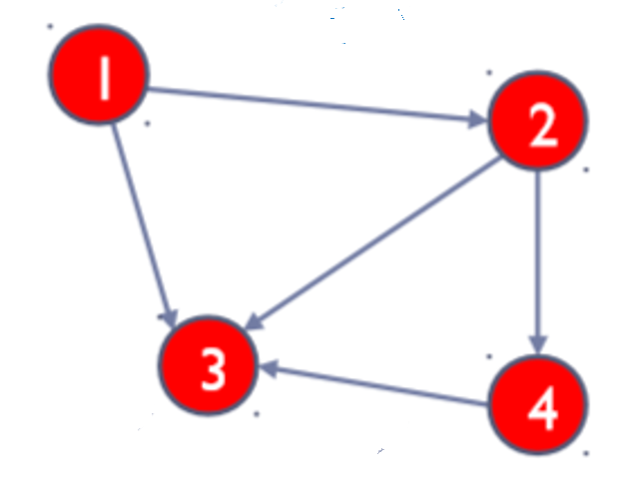
Can we study their interactions as a network?
Can we study their interactions as a network?
Graph
Communication
Anne: Jim, tell the Murrays they’re invited
Jim: Mary, you and your dad should come for dinner!
Jim: Mr. Murray, you should both come for dinner.
Anne: Mary, did Jim tell you about the dinner? You must come.
John: Mary, are you hungry?
…
Vertex
(Node)
Edge
(Link)

Slide 5
Friend1 | Friend2
John Audland | Charles Marshall
John Audland | George Fox
John Audland | Anne Camm
Francis Howgill | Martha Simmonds
Francis Howgill | James Nayler
Francis Howgill | Edward Burrough
Francis Howgill | George Fox
Francis Howgill | Richard Farnworth
Francis Howgill | William Crouch
William Bradford | William Penn
William Bradford | Tace Sowle
John Bellers | Fettiplace Bellers
William Rogers | Thomas Ellwood
William Rogers | George Whitehead
Martha Simmonds | Hannah Stranger
Martha Simmonds | James Nayler
Isabel Yeamans | William Penn
George Fox | Margaret Fell
George Fox | Ellis Hookes
A Network of Friends
Facebook
Twitter
Instagram
LinkedIn

Slide 6
Viral Marketing
You have developed a novel new product. You believe “word of mouth” is the key for the success of your new product. You want to start a viral marketing campaign. And your company’s data analyst has obtained a list of the people you want to target and their interactions from social media…
What should you do?

Slide 7
Commonly Used SNA Metrics
Network Size
Number of nodes
Out-degree
Sum of connections from you to others
In-degree
Sum of connections to you
Network Density
Number of ties that are present over the amount of ties that could be present
Various Centralities
Measure of power and prestige in a network

Slide 8
Density
A networks’ density is the ratios of the number of edges in the network over the total number of possible edges between all pairs of nodes (which is n(n-1)/2, where n is the number of vertices , for an undirected graph).
In the example network to the right density =5/6 (i.e., it is a fairly dense network; opposite would be a sparse network)
It is a common measure of how well connected a network is ( in other words, how closely knit it it) – a perfectly connected network is called a clique and has density =1
A directed graph will have half the density of its undirected equivalent, because there are twice as many possible edges, i.e., n(n-1)
1
2
3
4

Slide 9
Paths and shortest paths
Mary
A path between two nodes is any sequence of non-repeating nodes that connects the two nodes
The shortest path between two nodes is that path that connects the two nodes with the shortest number of edges (also called the distance between the nodes)
In the example to the right, the shortest path between nodes Mary and Tom
{ Mary, Katie, Tom}
{Mary, Jason, Tom}
Other, longer paths between the two nodes
{Mary, Jason, Katie, Tom}, {Mary, Katie, Jason, Tom}, {Mary, Katie, John, Jason, Tom} and {Mary, Jason, John, Katie, Tom)
Jason
Katie
John
Tom

Slide 10
Centrality measure
Interpretation in social network
Degree Centrality
How many people can this person reach directly?
How well is this person connected to other well-connected people?
How fast can this person reach everyone in the network?
How likely is this person to be the most direct route between two people in the network?
Eigenvector Centrality
Closeness Centrality
Betweenness Centrality

Slide 11
Degree Centrality
A node’s (in-) or (out-) degree is the number of links that lead into or out of the node
In an undirected graph they are of course identical
Useful in assessing which nodes are central with respect to spreading information and influencing others in their immediate “neighborhood”
Nodes with the highest degree
John (4)
Tom (4)
2
Mary
3
4
John
Jason
Katie
1
4
Tom
Louise
William
1
1

Slide 12
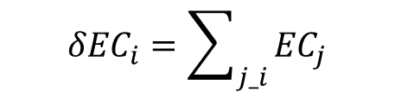
Eigenvector Centrality
A node’s eigenvector centrality is proportional to the sum of the eigenvector centralities of all nodes directly connected to it
Useful in determining who is connected to the most connected nodes
Node with the highest eigenvector centrality
John followed by Jason and Tom
0.36
Mary
0.49
0.54
John
Jason
$${δEC}_{i}=\sum_{j_i}{{EC}_{j}}$$
Katie
0.19
0.49
Tom
Louise
William
0.17
0.17

Slide 13
Closeness Centrality
0.5
Calculate the mean length of all shortest paths from a node to all other nodes in the network (i.e., how many hops on average it takes to reach every other node)
Take the reciprocal of the above value so that higher values are better (indicate higher closeness)
It is a measure of reach, i.e. the speed with which information can reach other nodes from a given starting node
Node with the highest (i.e., best) closeness
John and Tom followed by Jason
Mary
0.67
0.75
John
Jason
Katie
0.46
0.75
Tom
Louise
William
0.46
0.46

Slide 14
Closeness Centrality: Node John
John-Katie: 1
John-Mary: 1
John-Jason: 1
John-Tom: 1
John-Louise: 2
John-William: 2
Mean of above: = 8/6
Closeness centrality = reciprocal of mean = 6/8 = .75
Mary
John
Jason
Katie
Tom
Louise
William

Slide 15
Betweenness Centrality
For a given node v, calculate the number of shortest paths between nodes i and j that pass through v, and divide by all shortest paths between nodes i and j
Sum the above values for all node pairs i, j
Usually normalized (e.g., the highest value is 1 or the sum of all betweenness centralities in the network is 1)
Shows which nodes are more likely to be in communication paths between other nodes
Node with the highest betweenness centrality
Tom has higher betweenness centrality than John
0
Mary
0.1
0.43
John
Jason
Katie
0
0.6
Tom
Louise
William
0
0

Slide 16
Between Centrality: Node John
Mary-Jason: 0
Mary-Katie: 1
Mary-Tom: 0.5
Mary-Louise: 0.5
Mary-William: 0.5
Jason-Katie: 1
Jason-Tom: 0
Jason-Louise: 0
Jason-William: 0
Katie-Tom: 1
Katie-Louise: 1
Katie-William: 1
Tom-Louise: 0
Tom-William: 0
Louise-William: 0
Betweenness Centrality = sum of above = 6.5
Mary
John
Jason
Katie
Tom
Louise
William

Slide 17
Viral Marketing Example: 1 Step Travel
2
Mary
The message can be forwarded to multiple users at the same time, but the travel distance of the message is limited to one step, which means if it travels more than one step in this network, it is no longer effective. Apply your knowledge in network centrality to select the best candidate.
3
4
John
Jason
Katie
1
4
Tom
Louise
William
1
1
Degree Centrality

Slide 18
Viral Marketing Example: Minimal Hops
0.5
Mary
0.67
Now the limit of the travel distance has been removed. Regardless of who you pick, every node in the network will eventually receive the message. But we want to ensure the lowest average number of hops.
0.75
John
Jason
Katie
0.46
0.75
Tom
Louise
William
0.46
0.46
Closeness Centrality

Slide 19
Viral Marketing Example: Disruption
0
Mary
Assume that the restriction on the travel distance is removed, but now a competitor has developed a strategy to remove a person from the network in order to disrupt the distribution. Identify the single riskiest person to be removed under your competitor’s strategy?
0.1
0.43
John
Jason
Katie
0
0.6
Tom
Louise
William
0
0
Betweenness Centrality

Slide 20
Run Network Analysis in Python
Use Networkx
Define Nodes and Edges
Get Density
pip install networkx
G = nx.Graph()
G.add_nodes_from(node_names)
G.add_edges_from(edges)
density = nx.density(G)
print("Network density:", density)

Slide 21
Get the Shortest Path
from Margaret Fell to George Whitehead
fell_whitehead_path = nx.shortest_path(G, source="Margaret Fell", target="George Whitehead")
print("Shortest path between Fell and Whitehead:", fell_whitehead_path)
print("Length of that path:", len(fell_whitehead_path)-1)
Shortest path between Fell and Whitehead: ['Margaret Fell', 'George Fox', 'George Whitehead']
Length of that path: 2

Slide 22
Generate Centrality Measures
degree_dict = dict(G.degree(G.nodes())) # Run degree centrality
betweenness_dict = nx.betweenness_centrality(G) # Run betweenness centrality
eigenvector_dict = nx.eigenvector_centrality(G) # Run eigenvector centrality
closeness_dict = nx.closeness_centrality(G) # Run eigenvector centrality
# Assign each to an attribute in your network
nx.set_node_attributes(G, degree_dict, 'degree’)
nx.set_node_attributes(G, betweenness_dict, 'betweenness')
nx.set_node_attributes(G, eigenvector_dict, 'eigenvector')
nx.set_node_attributes(G, closeness_dict, 'closeness')
Top 10 nodes by degree:
('George Fox', 22)
('William Penn', 18)
('James Nayler', 16)
('George Whitehead', 13)
('Margaret Fell', 13)
('Benjamin Furly', 10)
('Edward Burrough', 9)
('George Keith', 8)
('Thomas Ellwood', 8)
('Francis Howgill', 7)
Top 10 nodes by betweenness centrality:
('William Penn', 0.23999456006192205)
('George Fox', 0.23683257726065216)
('George Whitehead', 0.12632024847366005)
('Margaret Fell', 0.12106792237170329)
('James Nayler', 0.10446026280446098)
('Benjamin Furly', 0.06419626175167242)
('Thomas Ellwood', 0.046190623885104545)
('George Keith', 0.045006564009171565)
('John Audland', 0.04164936340077581)
('Alexander Parker', 0.03893676140525336)

Slide 23
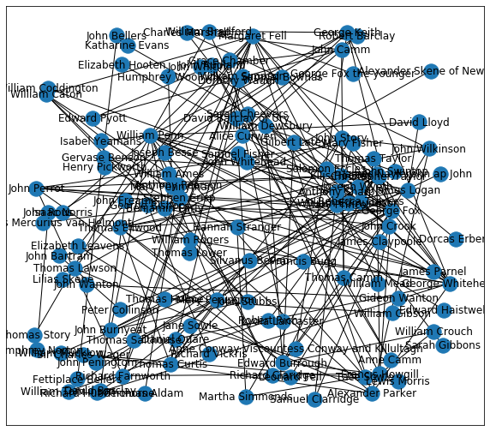
Draw the graph using the random layout
# Draw the graph using the random layout
import matplotlib.pyplot as plt
plt.figure(figsize=(10,9))
pos = nx.random_layout(G)

Slide 24
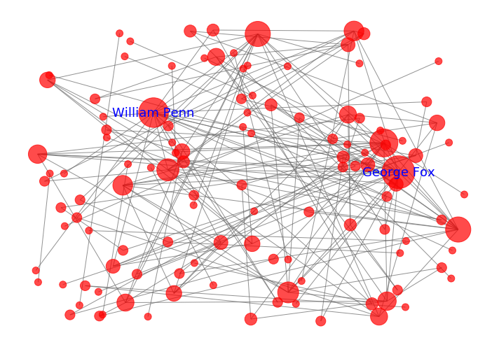
Draw the customized graph
# Draw the graph adding alpha, removing labels, and softening edge color
plt.figure(figsize=(10,7))
node_size = [100*nx.get_node_attributes(G, 'degree')[v] for v in G]
nx.draw_networkx(G, pos, alpha=0.7, with_labels=False,node_size = node_size, edge_color='.4',node_color='red')
#d = nx.degree(G)
nx.draw_networkx_labels(G, pos, labels={'George Fox': 'George Fox', 'William Penn': 'William Penn'}, font_size=18, font_color='blue')
plt.axis('off')
plt.tight_layout();

Slide 25
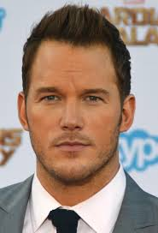

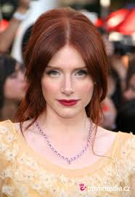
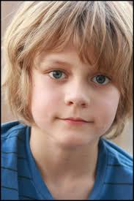
The Role of Network Embeddedness in Film Success
G.Packard, A. Aribarg, J. Eliashberg
And N.Foutz

Slide 26
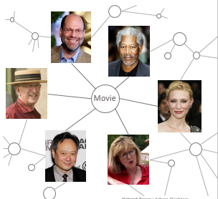
The Role of Network Embeddedness in Film Success
Two aspects of network embeddedness:
positional embeddedness (Eigenvector centrality)—how well a person is tied to well-connected others
junctional embeddedness (betweenness centrality)—the extent to which a person bridges sub-communities in the industry

Slide 27
Community Detection and Modularity
The process of seeking out communities within a network
Identify communities in a network
Based on that a group of nodes in a network are more densely connected internally than with others
Modularity
Measure the strength of division of a network into modules (/communities)
The fraction of the edges that fall within the given group - the expected fraction if edges were distributed at random
The higher the modularity, the more dense connections between the nodes within communities and the more sparse connections between nodes in different communities.

Slide 28
Detecting Community via Networkx
communities = community.greedy_modularity_communities(G)
modularity_dict = {}
for i,c in enumerate(communities):
for name in c:
modularity_dict[name] = i
nx.set_node_attributes(G, modularity_dict, 'modularity’)
for i,c in enumerate(communities):
if len(c) > 2:
print('Class '+str(i)+':', list(c))
Class 0: ['Peter Collinson', 'Thomas Story', 'Jane Sowle', 'Samuel Bownas', 'Richard Claridge', 'John Bartram', 'William Bradford', 'Anne Conway Viscountess Conway and Killultagh', 'George Keith', 'Isabel Yeamans', 'James Logan', 'Joseph Besse', 'David Lloyd', 'Tace Sowle', 'Edward Haistwell', 'Isaac Norris', 'William Penn']
Class 1: ['William Tomlinson', 'Thomas Lower', 'George Fox the younger', 'Margaret Fell', 'Gervase Benson', 'William Gibson', 'Dorcas Erbery', 'Francis Howgill', 'James Nayler', 'Martha Simmonds', 'Hannah Stranger', 'Elizabeth Leavens', 'Robert Rich', 'Thomas Aldam', 'Richard Farnworth', 'Anthony Pearson', 'Thomas Holme']

Slide 29
Now, besides the viral marketing, you also want to run a targeted advertising campaign: show different groups of people different ads. For example, through social media, you find that Richard Claridge interacted with the ad featuring the star Morgan Freeman. Who else do you want to show the ad to?

